Slide 1
Week 4
MySQL Aggregate Functions

Slide 2
Functions
A function is code that performs a specific task and that can be reused together later in a program
For example these are functions you have already used:
JavaScript Functions
MySQL Function
window.prompt();
parseInt(input);
console.log(input);
arr.pop();
arr.push();
CONCAT(column_1, column_2)

Slide 3
Functions Dissected
Functions…
…are identified & called by their names
…"take in" data (i.e. Inputs)
…complete some process
…“return” some data, changed
A
B
C
D
A
B
C
D
parseInt(“15”);
15
CONCAT(column_1, column_2)
“column_1column_2”

Slide 4

Function Flowchart
SELECT CONCAT(title, “ (”, release_year, “)”) FROM movie;
Start
CONCAT
(title, “ (”, release_year, “)”)
CONCAT(...)
Combine data
“Shrek (2001)”
End
End

Slide 5
SQL Aggregate Functions¹
Function - Reusable code that performs a specific task
Aggregate - A whole formed by combining several elements
Aggregate Function - Reusable code that combines several data values to return a single value
Sum data, average data, count data
Functions…
…are identified & called by their names
…“take in” data (i.e. Inputs)
…complete some process
…“return” some data, changed
Aggregate functions…
…are identified & called by their names
…“take in” data from multiple rows
…complete some process that condenses the data into a single number
…then “returns” the processed single number
¹ https://www.w3schools.com/sql/sql_aggregate_functions.asp

Slide 6
SQL Aggregate Functions¹
MAX() :
MIN() :
AVG() :
SUM() :
COUNT() :
SELECT MAX(runtime) FROM movie;
SELECT MIN(release_year) FROM movie;
SELECT AVG(runtime) FROM movie;
SELECT SUM(runtime) FROM movie;
SELECT COUNT(*) FROM movie;
¹ https://www.w3schools.com/sql/sql_aggregate_functions.asp

Slide 7


MAX()¹ Function
MAX() returns the largest value of the selected column
Example: Find the longest running film
SELECT MAX(runtime) FROM movie;
Start
MAX
MAX(...)
Find Largest
End
End
Syntax
SELECT MAX(column) FROM table_name;
¹ https://www.w3schools.com/sql/sql_min_max.asp

Slide 8

MIN()¹ Function
MIN() returns the smallest value of the selected column
Example: Find the shortest running film
SELECT MIN(runtime) FROM movie;
Start
MIN
MIN(...)
Find Smallest
End
End
Syntax
SELECT MIN(column) FROM table_name;
¹ https://www.w3schools.com/sql/sql_min_max.asp

Slide 9

AVG()¹ Function
AVG() returns the smallest value of the selected column
Example: Find the average runtime
SELECT AVG(runtime) FROM movie;
Start
AVG
AVG(...)
Calculate average
End
End
Syntax
SELECT AVG(column) FROM table_name;
¹ https://www.w3schools.com/sql/sql_avg.asp

Slide 10

SUM()¹ Function
SUM() returns the smallest value of the selected column
Example: Find the total runtime of movies combined
SELECT SUM(runtime) FROM movie;
Start
SUM
SUM(...)
Sum all
End
End
Syntax
SELECT SUM(column) FROM table_name;
¹ https://www.w3schools.com/sql/sql_sum.asp

Slide 11
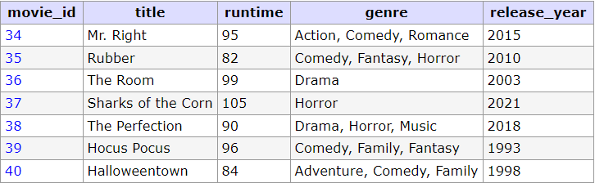

COUNT()¹ Function
COUNT() returns the number of rows that were selected
Example: How many movies are in the database?
SELECT COUNT(*) FROM movie;
Start
COUNT
COUNT(...)
Count rows
End
End
Syntax
SELECT COUNT(column) FROM table_name;
¹ https://www.w3schools.com/sql/sql_count.asp

Slide 12
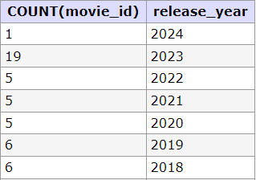
GROUP BY¹
GROUP BY statement groups rows with the same values into summary rows
Example: Count all the movies grouped by their release year
SELECT COUNT(movie_id), release_year
FROM movie
GROUP BY release_year;
GROUP BY can be used with the aggregate functions
to group the result-set by one or more columns
COUNT(), MAX(), MIN(), SUM(), AVG()
Syntax
SELECT AGG_FUNCTION(column) FROM table_name
GROUP BY column_1, column_2, ...;
¹ https://www.w3schools.com/sql/sql_groupby.asp

Slide 13
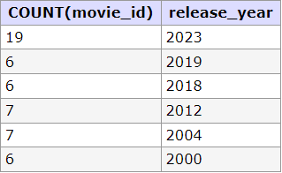
HAVING¹
HAVING, added because WHERE cannot be used with aggregate functions
Example: Count all the movies grouped by their release year
SELECT COUNT(movie_id), release_year FROM movie GROUP BY release_year HAVING COUNT(movie_id)>5;
Syntax
SELECT AGG_FUNCTION(column) FROM table_name
GROUP BY column(s) HAVING condition(s);
¹ https://www.w3schools.com/sql/sql_having.asp

Slide 14
SELECT Syntax
SELECT column(s), FUNCTION(column), ...
FROM table_name
WHERE condition(s)
GROUP BY column(s)
HAVING condition(s)
ORDER BY column(s) ASC|DESC
LIMIT num_limit
OFFSET num_offset;
SELECT column(s), FUNCTION(column), ...
FROM table_name
WHERE condition(s)
GROUP BY column(s)
HAVING condition(s)
ORDER BY column(s) ASC|DESC
LIMIT num_limit
OFFSET num_offset;

Slide 15
Next (Week 5)
Lesson - Multiple Tables
Lab 5 (8%)

Slide 16
W4 Summary
Terminology
Aggregate Functions - function that performs a calculation on a set of values, and returns a single value
In SQL - MAX, MIN, AVG, SUM, COUNT

Slide 17
W4 Summary
SQL Keywords
MAX() :
MIN() :
AVG() :
SUM() :
COUNT() :
GROUP BY :
HAVING :
SELECT MAX(runtime) FROM movie;
SELECT MIN(release_year) FROM movie;
SELECT AVG(runtime) FROM movie;
SELECT SUM(runtime) FROM movie;
SELECT COUNT(*) FROM movie;
SELECT ... GROUP BY release_year;
SELECT ... HAVING COUNT(movie_id)>5;

Slide 18
W4 Summary
Practice
W3Schools SQL
MAX, MIN, AVG, SUM, COUNT, GROUP BY, HAVING
SQL BOLT
SQL Lesson 8: A short note on NULLs
SQL Lesson 9: Queries with expressions
SQL Lesson 10: Queries with aggregates (Pt. 1)
SQL Lesson 11: Queries with aggregates (Pt. 2)

